Slide 1
Group 4 - Visualising CNNs
Richard Luks
Shayekh Mohiuddin Ahmed Navid
01. February 2024

Slide 2
Visualising CNNs
Why visualise Convolutional Neural Networks?

Slide 3
Agenda
Visualising and Understanding Convolutional Networks (Zeiler & Fergus, 2014)
Understanding Deep Image Representation by Inverting Them (Mahendran & Vedaldi, 2014)
Summary
4
12
26

Slide 4
Visualising and Understanding Convolutional Networks (Zeiler & Fergus, 2014)

Slide 5
Motivation and Solution
Motivation
Understanding CNNs
Solution: Deconvnets („reverse of convolutional layer“)
Visualising feature map activations
Evolution of feature maps (during training)
Image occlusion
Zeiler, M. D., & Fergus, R. (2014). Visualizing and understanding convolutional networks. In Lecture Notes in Computer Science (pp. 818–833). https://doi.org/10.1007/978-3-319-10590-1_53

Slide 6
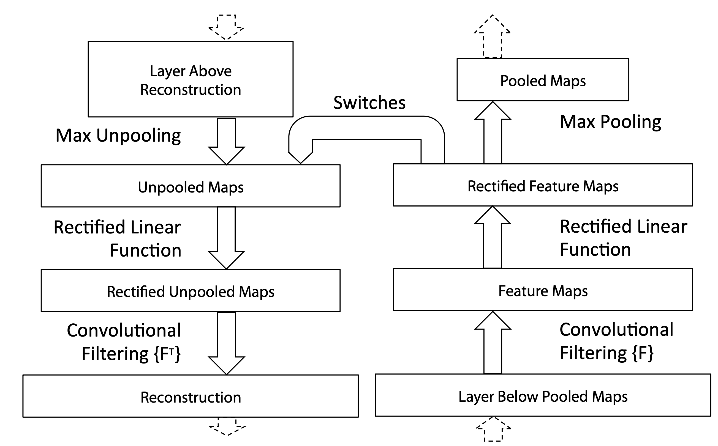
Deconvnet
Deconvnet
Convnet Layer
Feature Map Activation or Previous Deconvnet‘s Reconstruction
Output from Current Convnet Layer
Current Layer‘s Reconstruction
Input Image / Output from Previous Convnet Layer
Zeiler, M. D., & Fergus, R. (2014). Visualizing and understanding convolutional networks. In Lecture Notes in Computer Science (pp. 818–833). https://doi.org/10.1007/978-3-319-10590-1_53

Slide 7
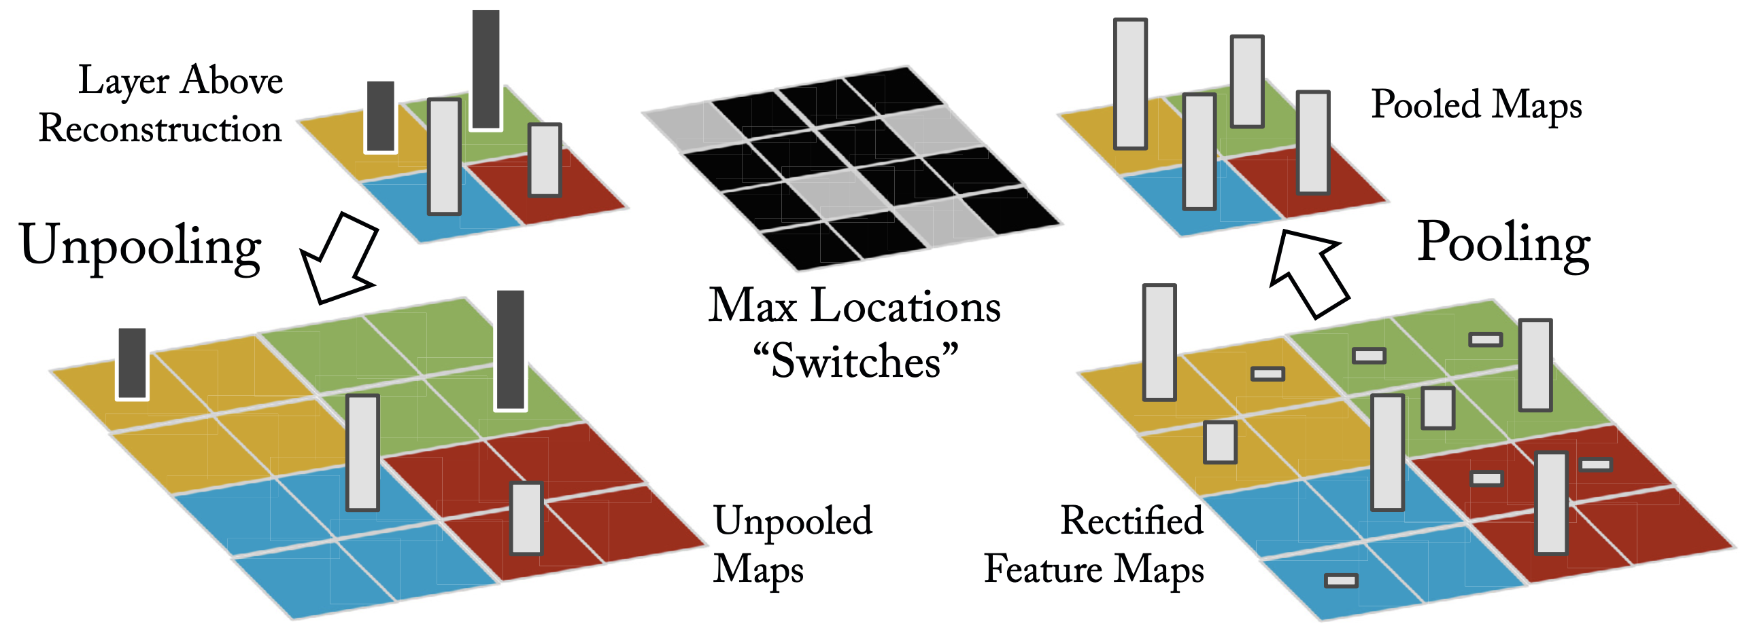
Unpooling
Zeiler, M. D., & Fergus, R. (2014). Visualizing and understanding convolutional networks. In Lecture Notes in Computer Science (pp. 818–833). https://doi.org/10.1007/978-3-319-10590-1_53

Slide 8
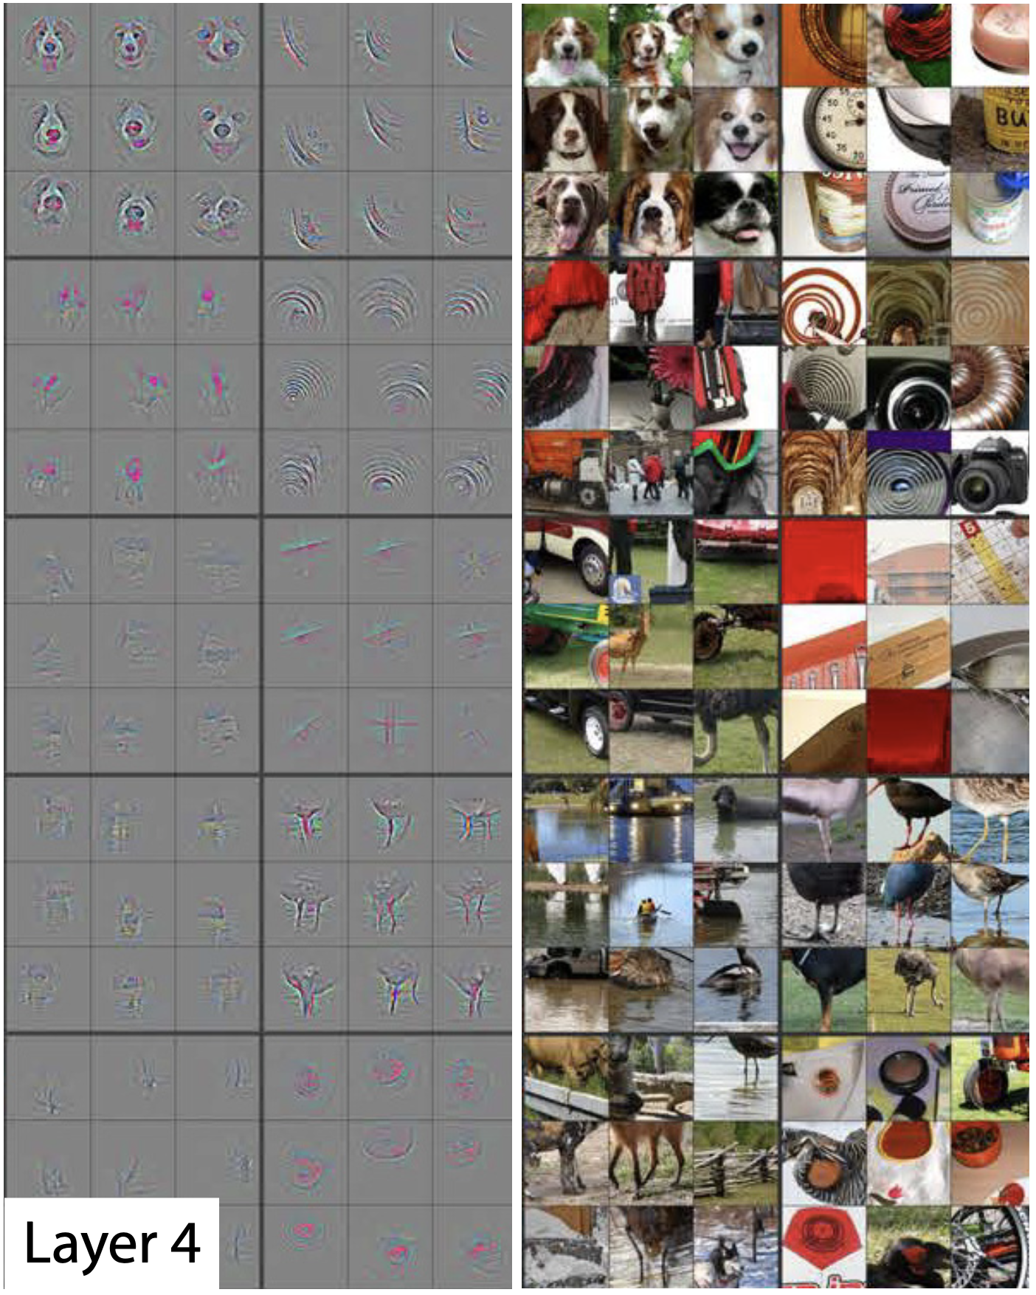
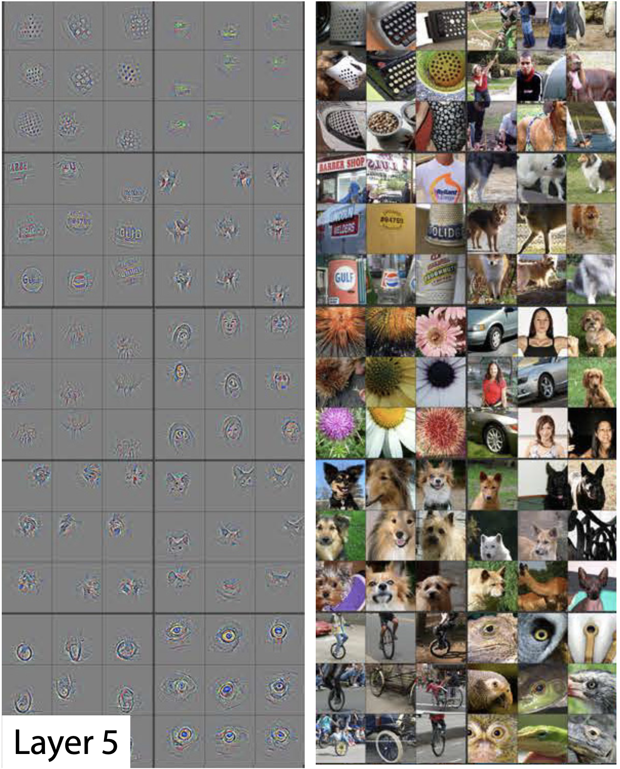
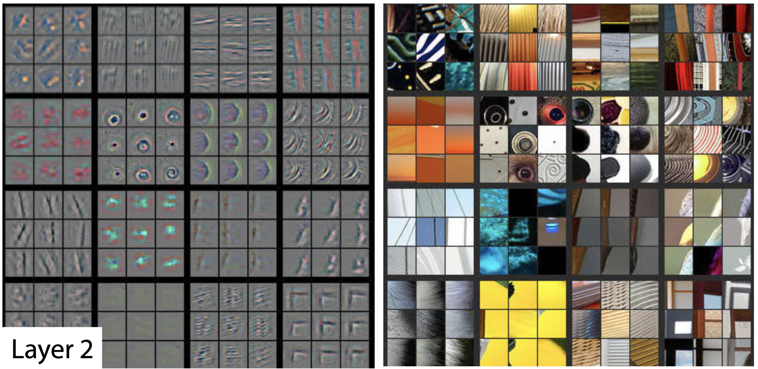
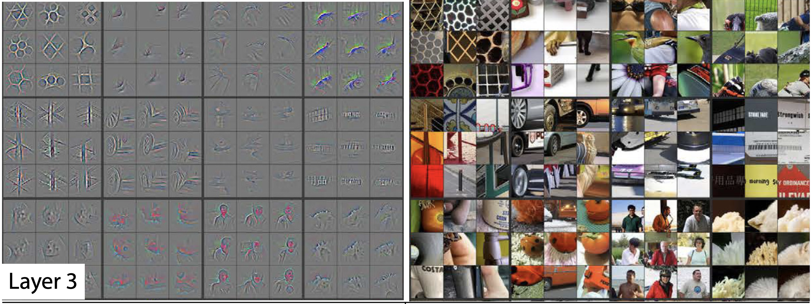
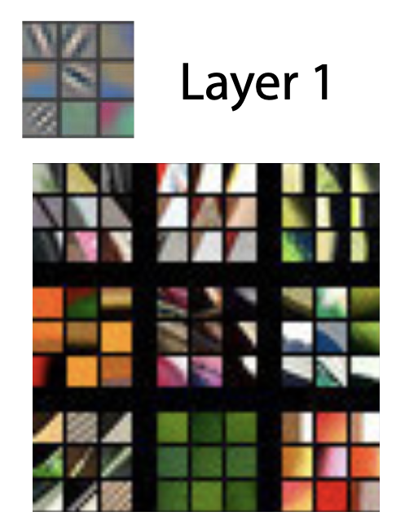
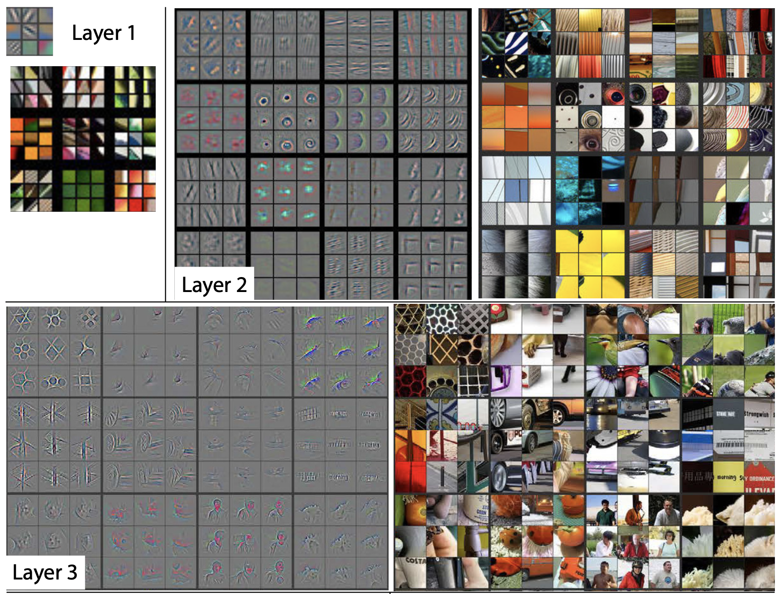
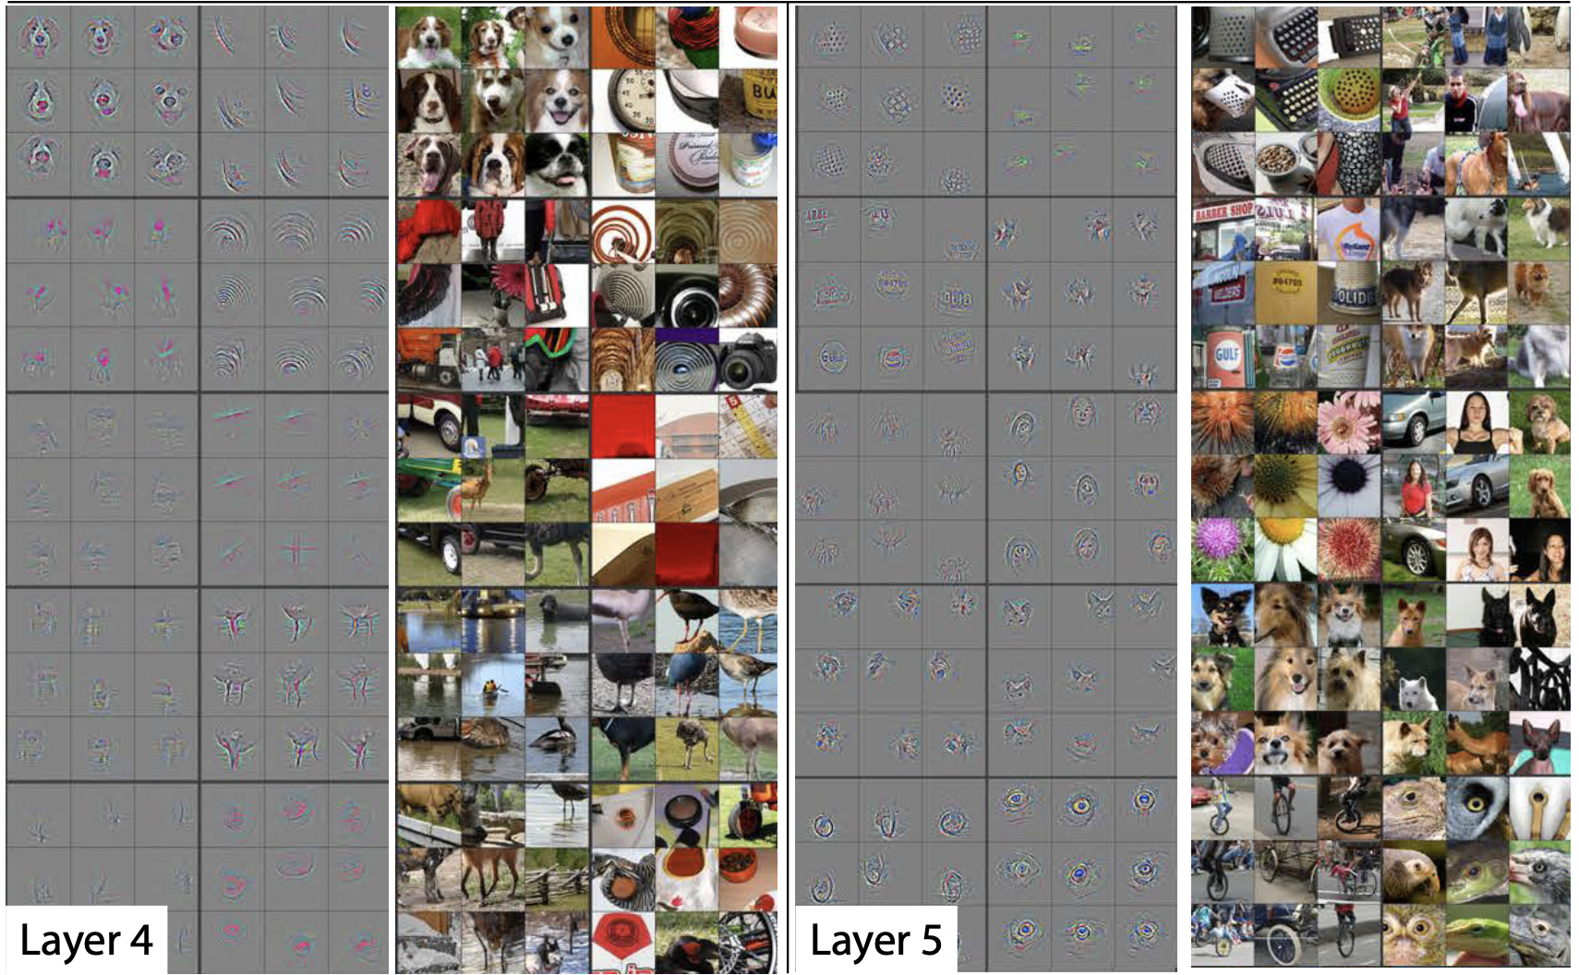
Visualising Feature Map Activations
Zeiler, M. D., & Fergus, R. (2014). Visualizing and understanding convolutional networks. In Lecture Notes in Computer Science (pp. 818–833). https://doi.org/10.1007/978-3-319-10590-1_53

Slide 9
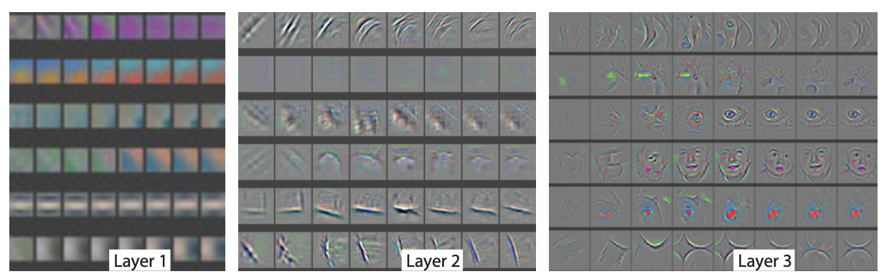
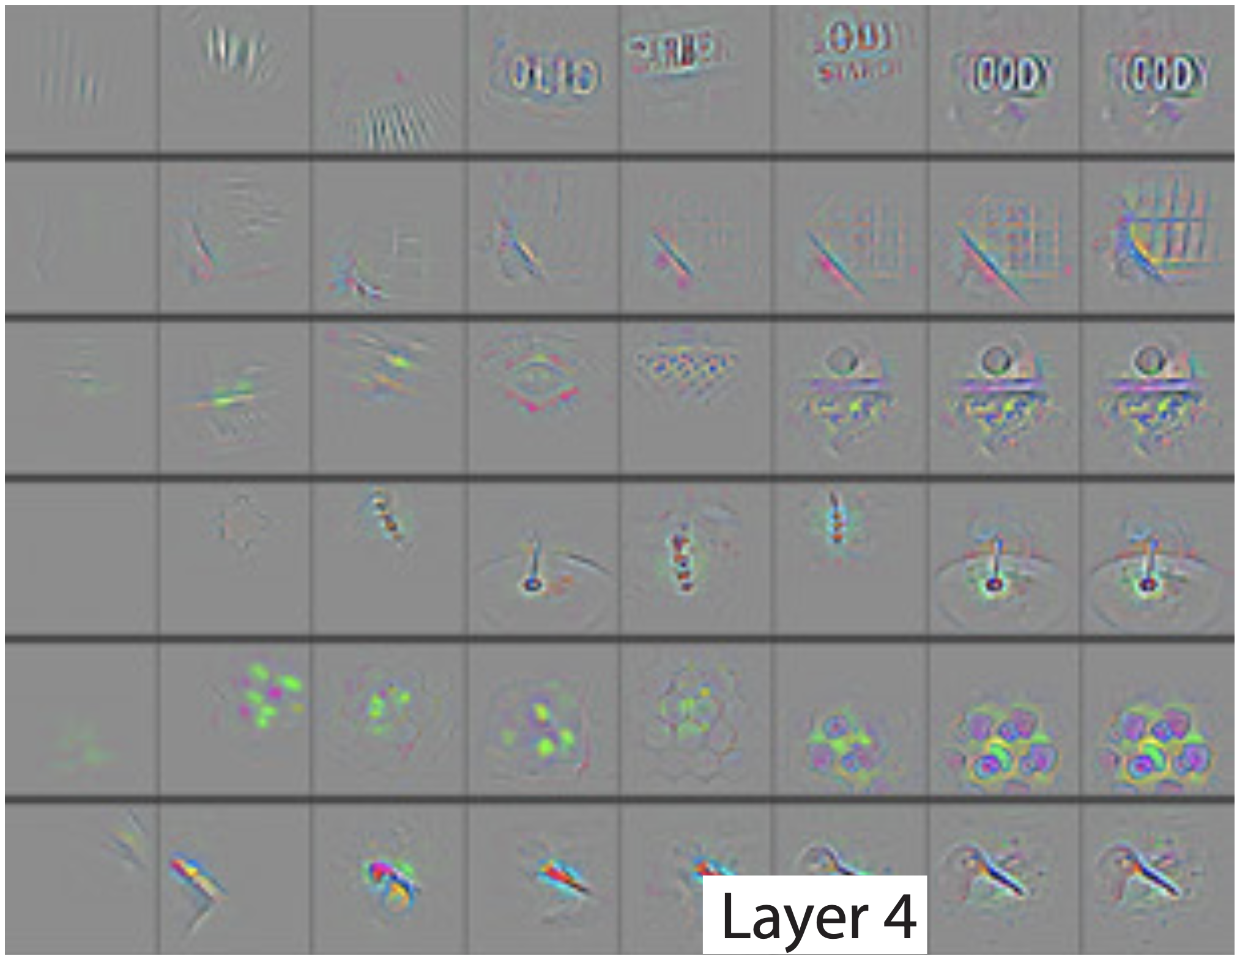
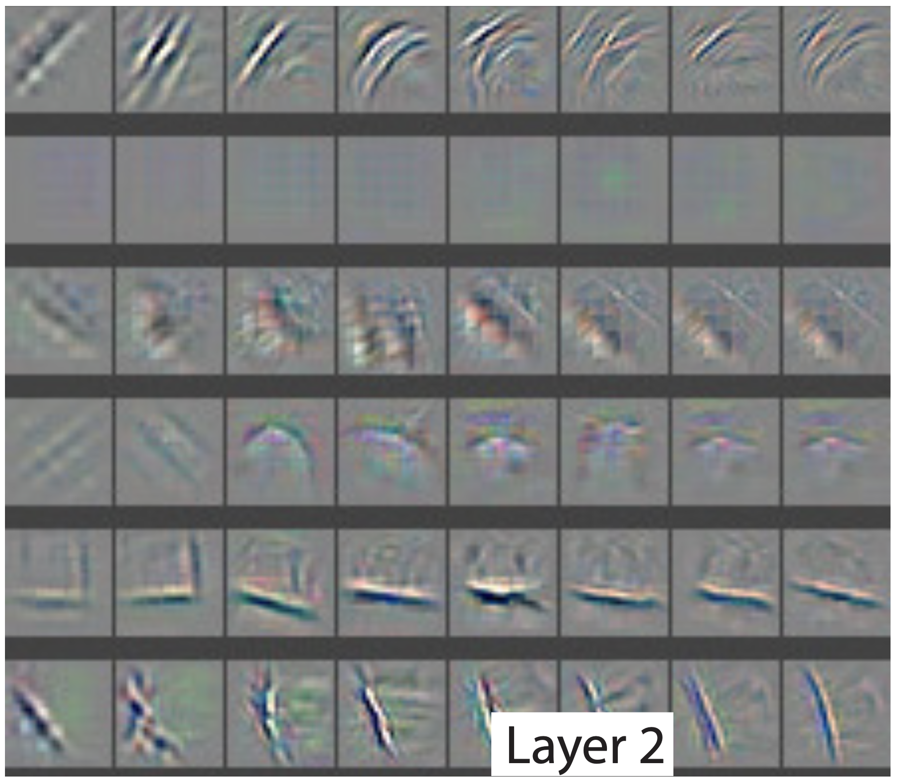
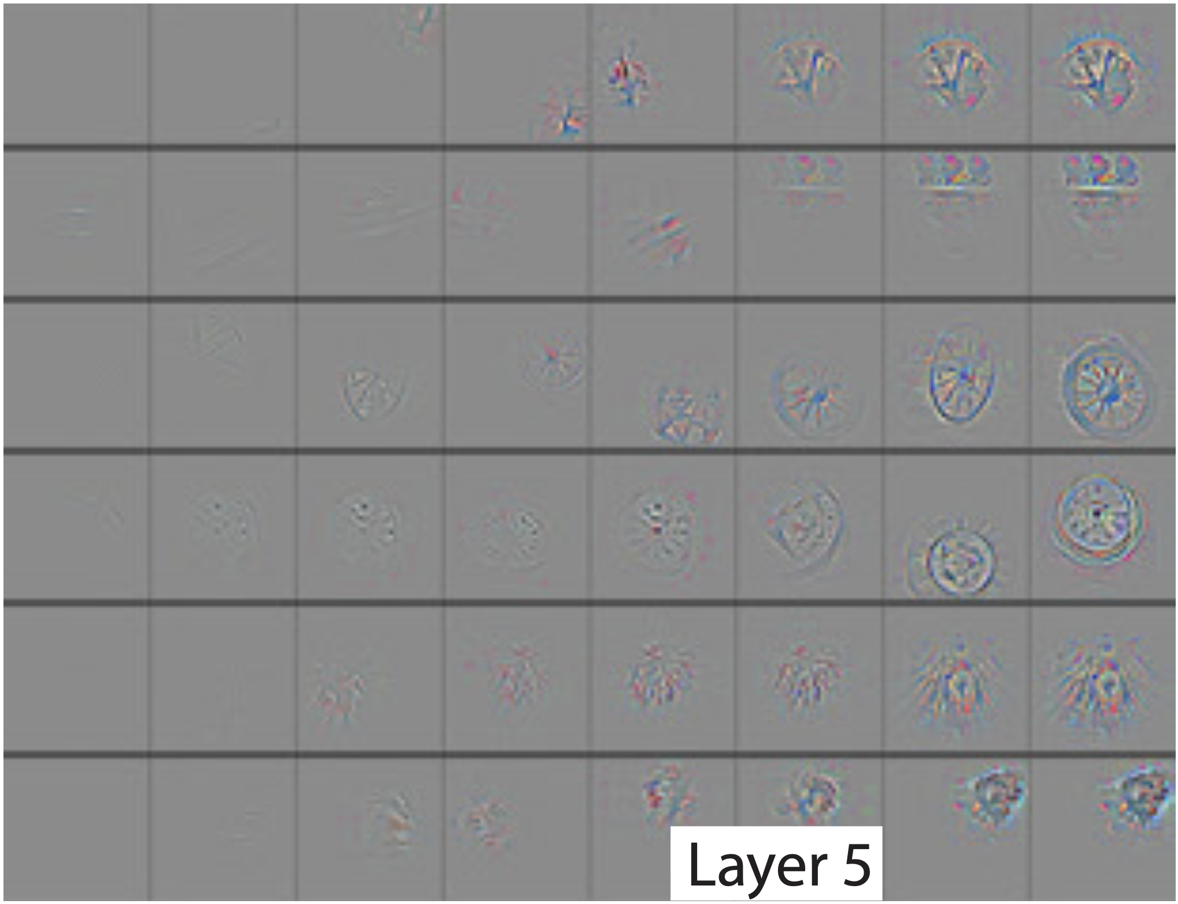
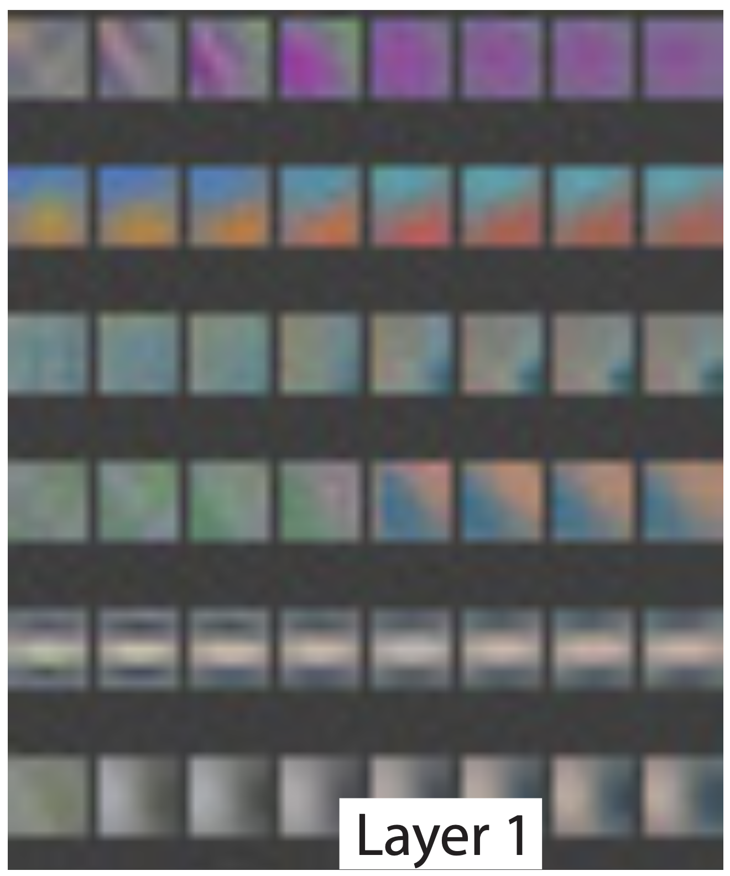
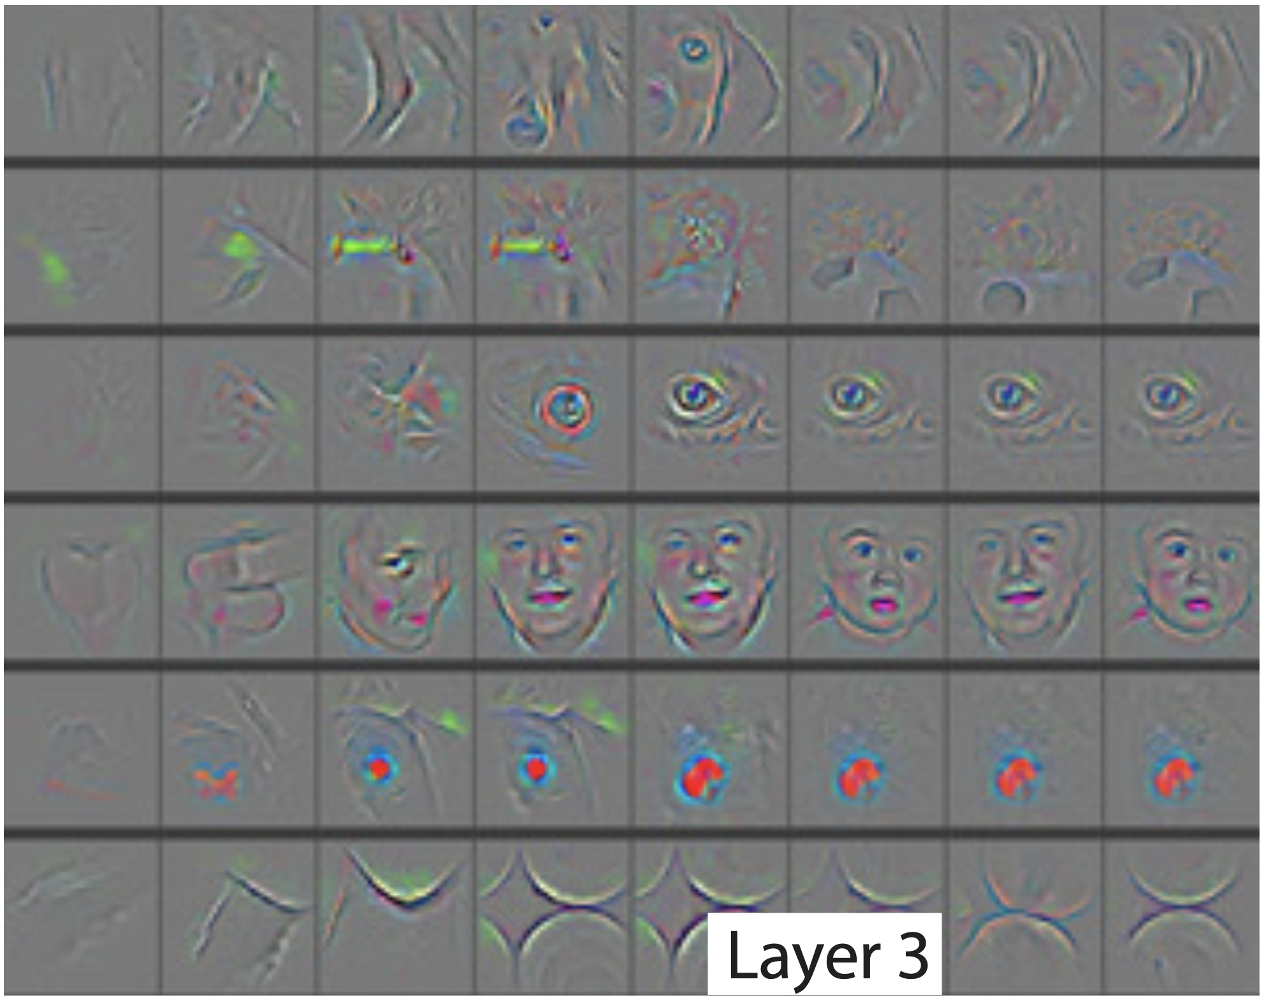
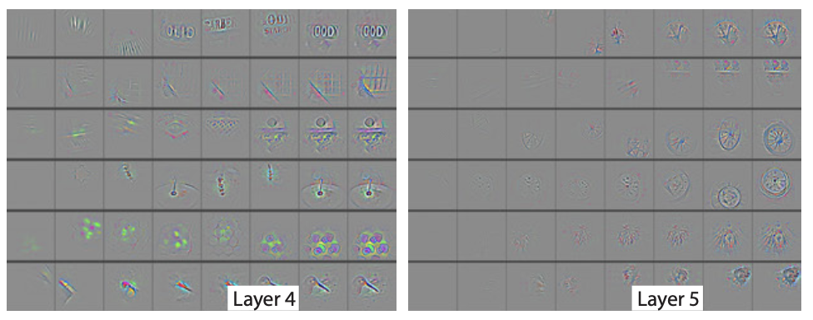
Evolution of Feature Maps
1 2 5 10 20 30 40 64
1 2 5 10 20 30 40 64
1 2 5 10 20 30 40 64
1 2 5 10 20 30 40 64
1 2 5 10 20 30 40 64
Zeiler, M. D., & Fergus, R. (2014). Visualizing and understanding convolutional networks. In Lecture Notes in Computer Science (pp. 818–833). https://doi.org/10.1007/978-3-319-10590-1_53

Slide 10
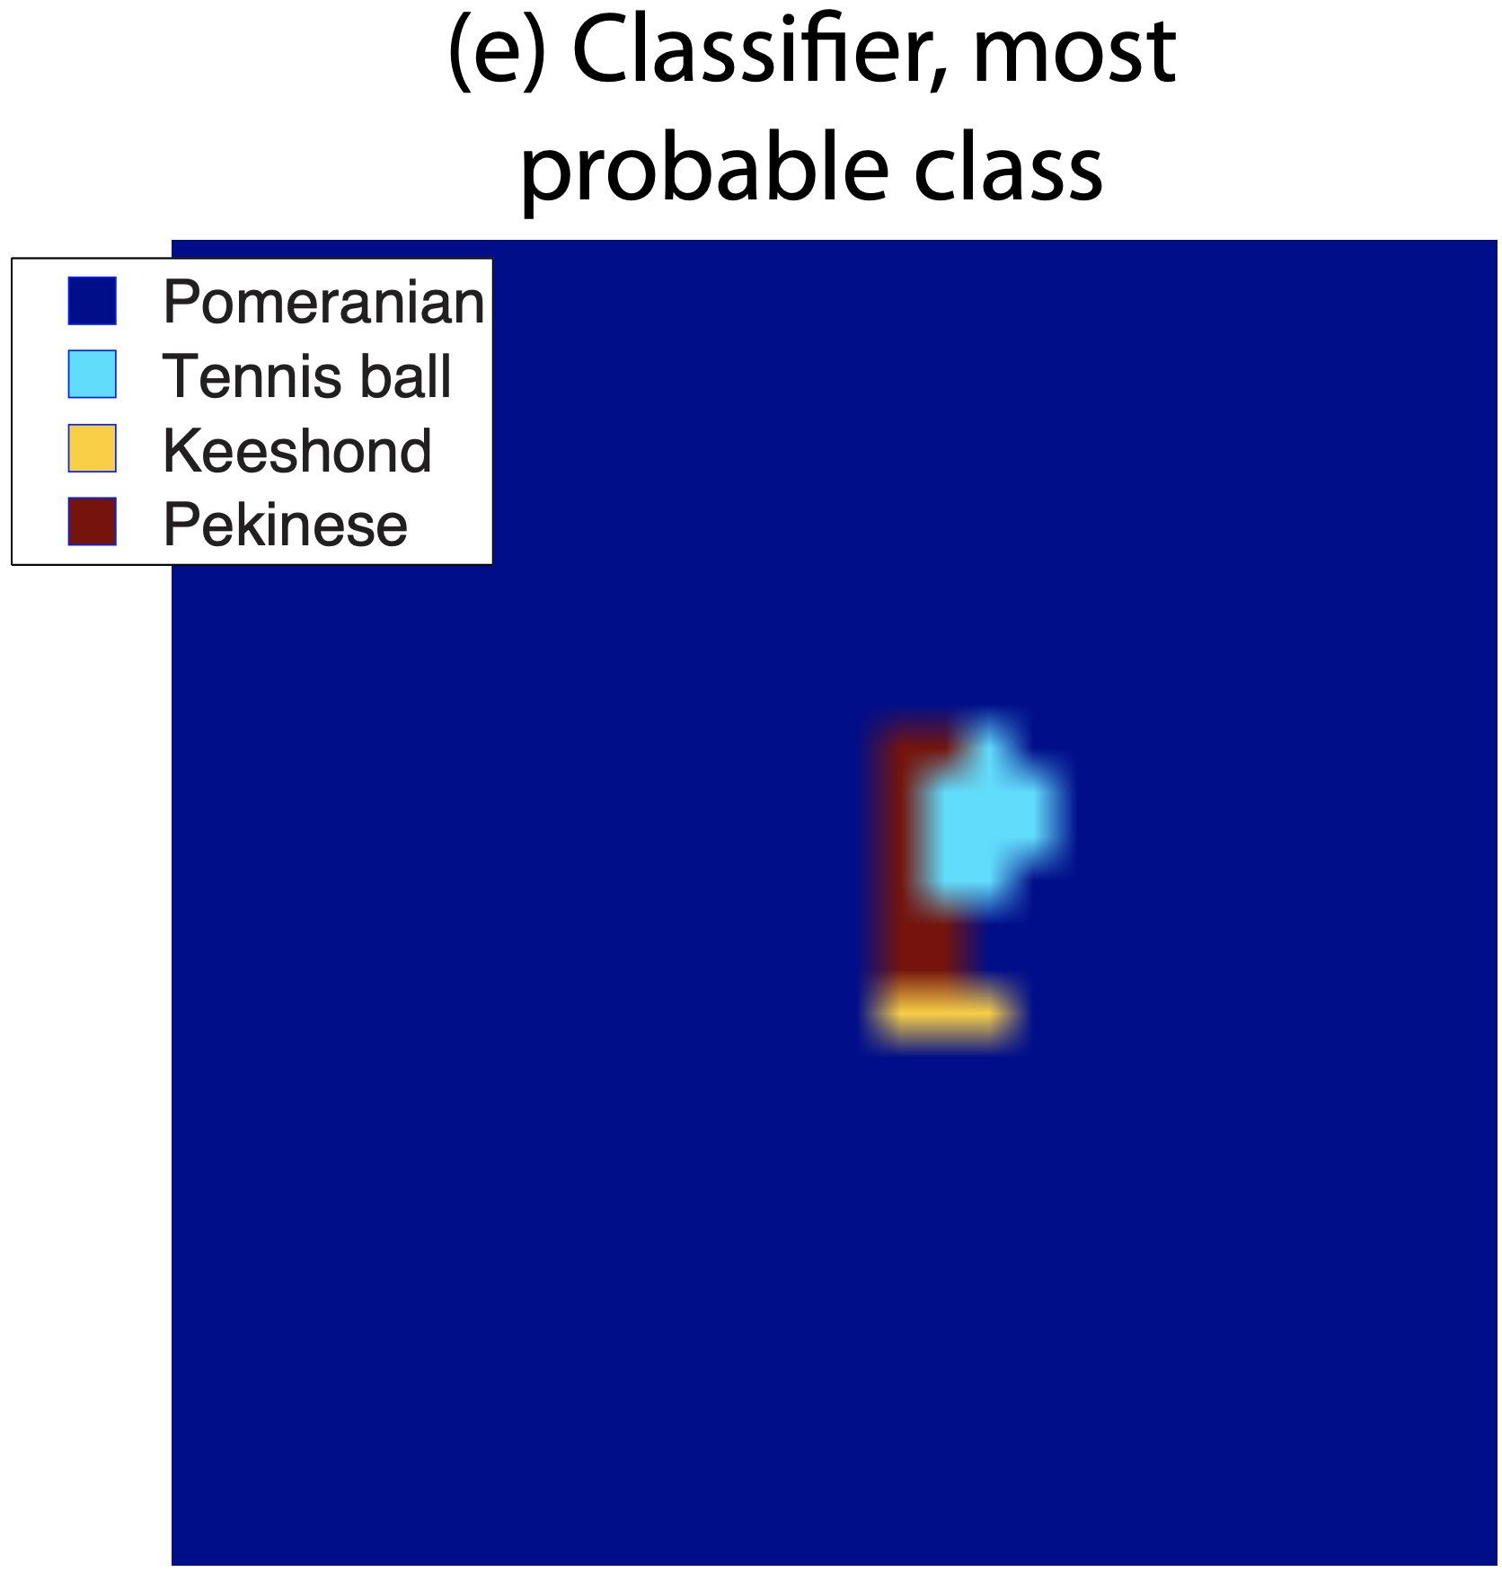
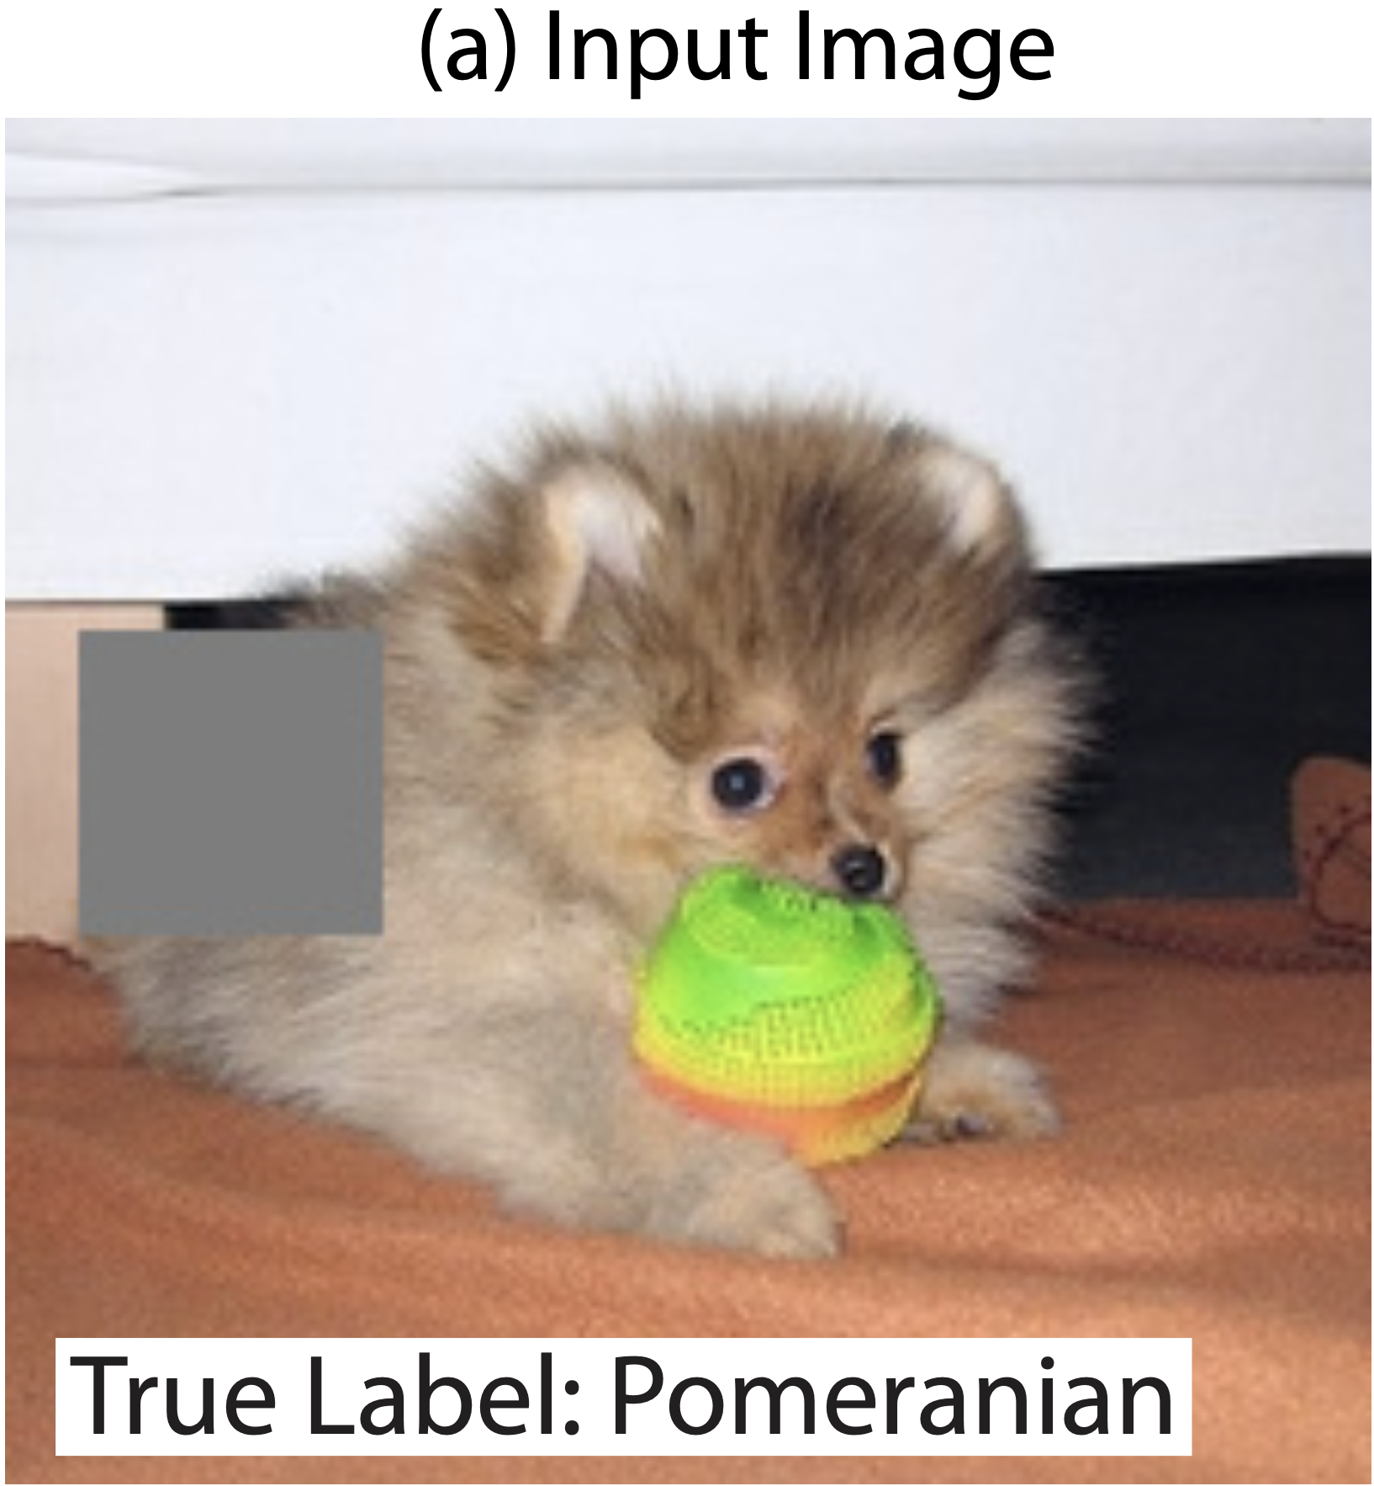
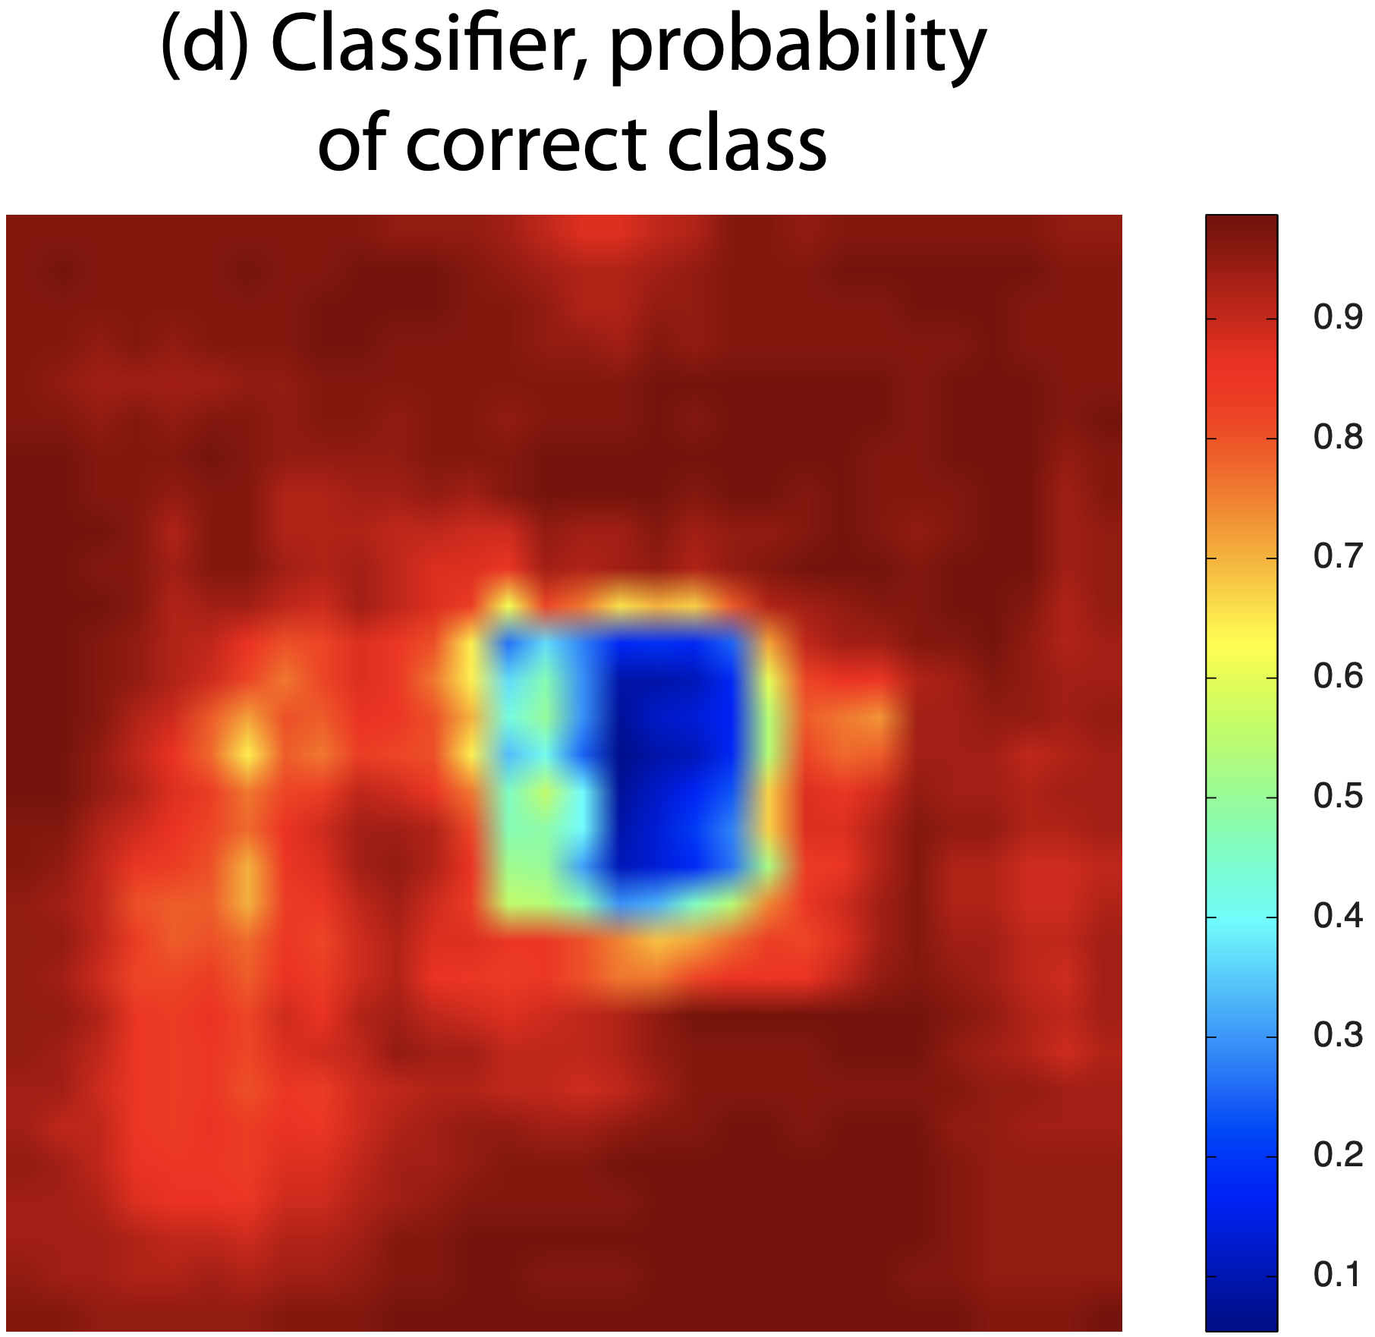
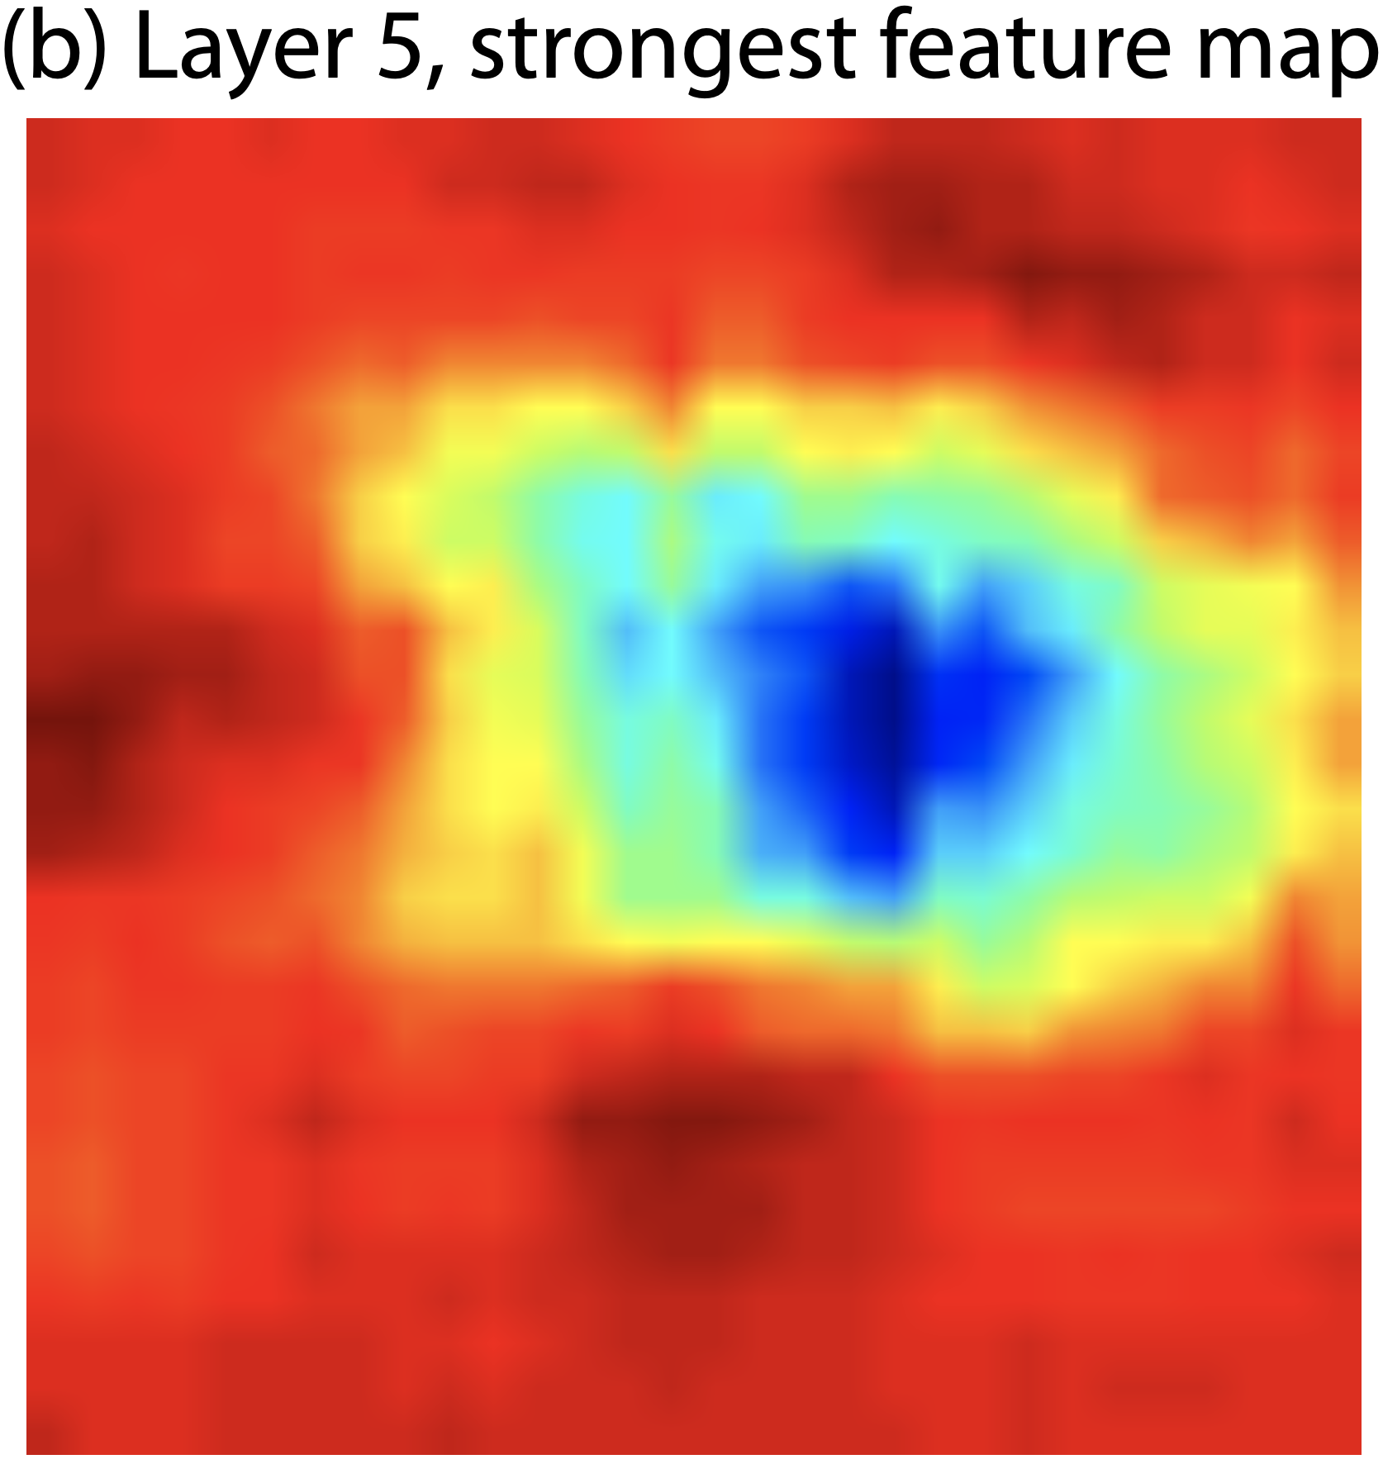
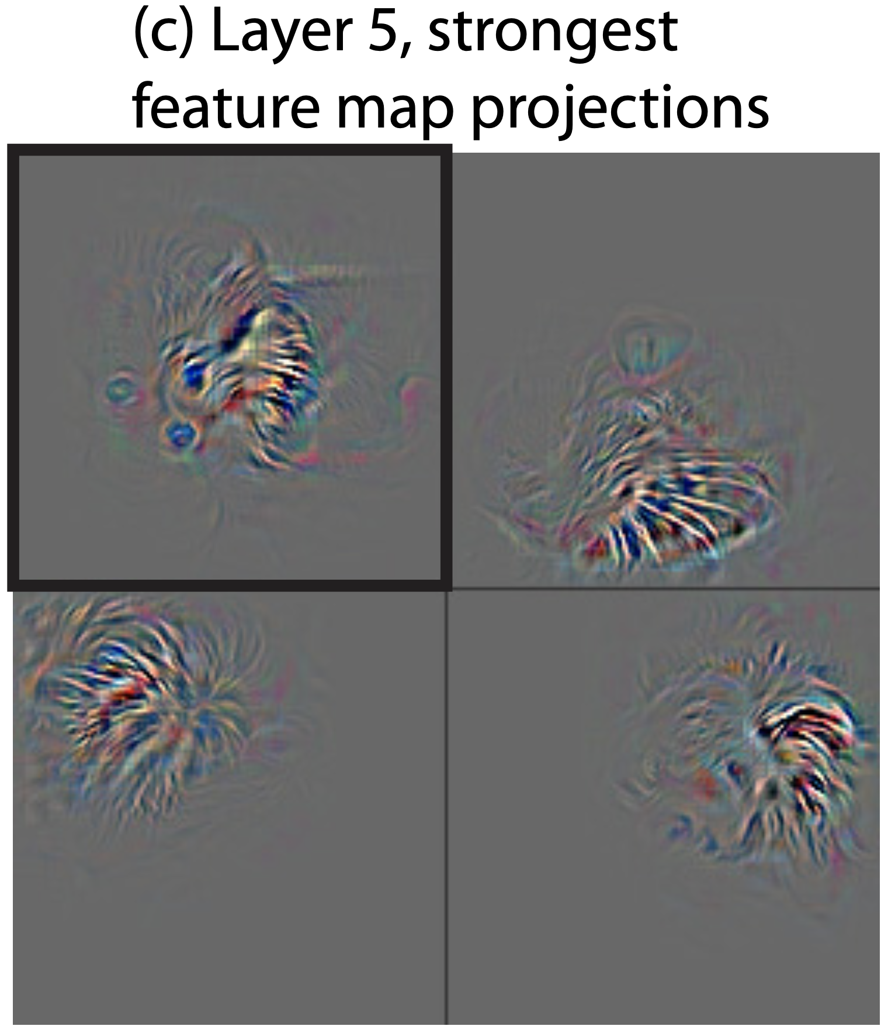
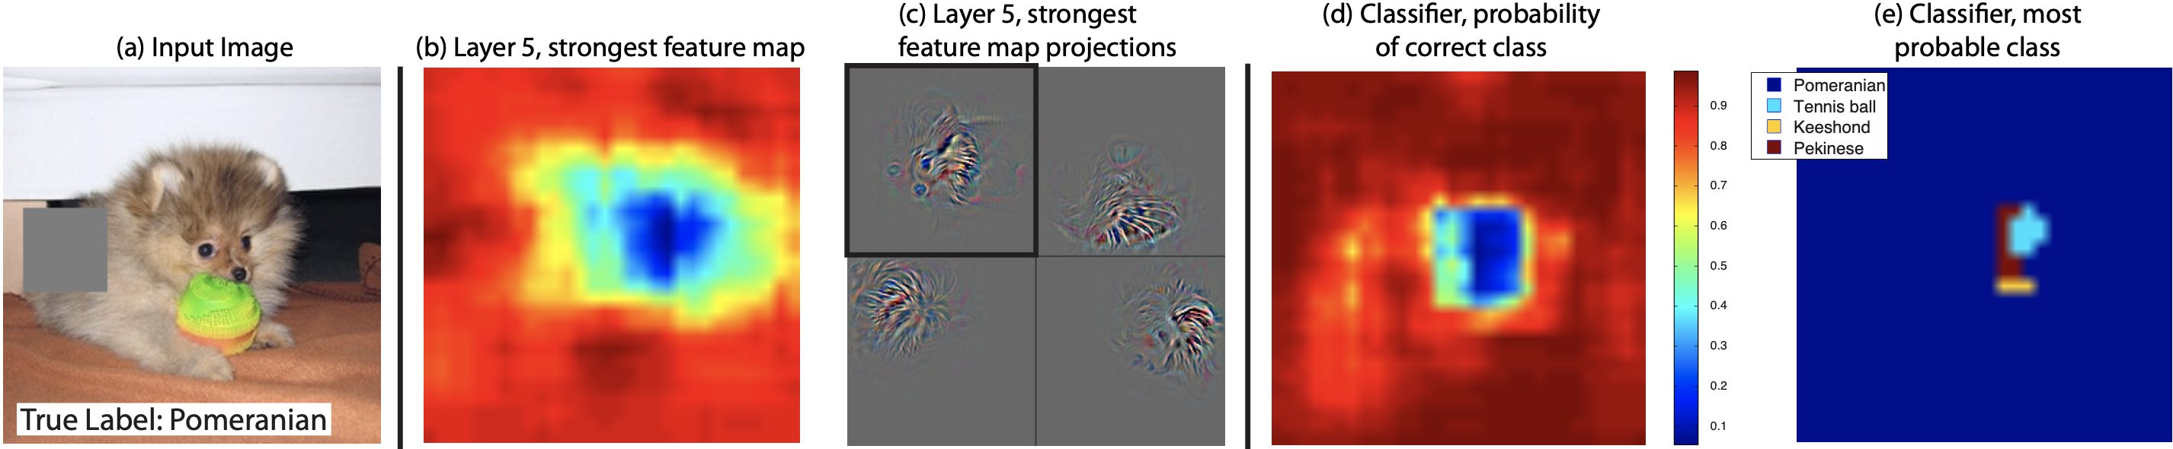
Image Occlusion
Zeiler, M. D., & Fergus, R. (2014). Visualizing and understanding convolutional networks. In Lecture Notes in Computer Science (pp. 818–833). https://doi.org/10.1007/978-3-319-10590-1_53

Slide 11
Summary
Shallower layers‘ representations are less sophisticated than deeper layers‘ representations
Shallower layers learn representations faster than deeper layers do
Feature maps learn local parts of the image (as opposed to some context information of the image)

Slide 12
Understanding Deep Image Representations by Inverting Them (Mahendran & Vedaldi, 2014)

Slide 13
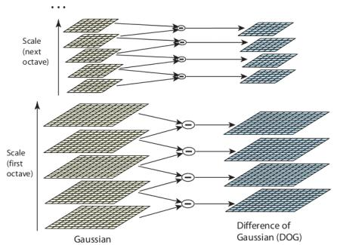
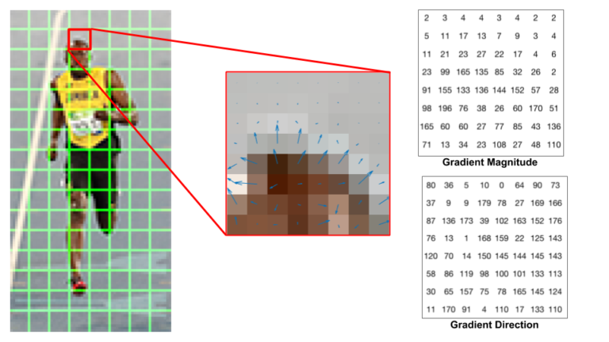
Introduction
Previous Paper deals with CNN representations only.
But what happens when you want to understand representations for other Computer Vision algorithms such as DSIFT and HOG ?
OpenCV: Introduction to SIFT (Scale-Invariant Feature Transform). (n.d.). https://docs.opencv.org/3.4/da/df5/tutorial_py_sift_intro.html
Mittal, K. (2021, December 24). A gentle introduction into the histogram of oriented gradients. Medium. https://medium.com/analytics-vidhya/a-gentle-introduction-into-the-histogram-of-oriented-gradients-fdee9ed8f2aa

Slide 14
Introduction
WHY ?

Slide 15
Motivation
Limited understanding of these representations
SIFT Limitations
Computational Intensity
Memory Usage
Sensitivity to Noise
Limited to 2D Transformations
HOG Limitations
Limited Spatial Information
Sensitivity to Illumination Changes
Challenges with Small Objects
Complexity in Parameter Tuning

Slide 16
Introduction
Traditional methods (SIFT, HOG) to deep neural networks
SIFT (Scale-Invariant Feature Transform):
Identifies key points in an image
SIFT works by identifying and describing distinctive local features in an image, maintaining scale and rotation invariance
HOG (Histogram of Oriented Gradients):
HOG captures object shape and structure
It creates a feature vector based on gradient orientations, commonly applied in object detection.
Mittal, K. (2021, December 24). A gentle introduction into the histogram of oriented gradients. Medium. https://medium.com/analytics-vidhya/a-gentle-introduction-into-the-histogram-of-oriented-gradients-fdee9ed8f2aa
OpenCV: Introduction to SIFT (Scale-Invariant Feature Transform). (n.d.). https://docs.opencv.org/3.4/da/df5/tutorial_py_sift_intro.html

Slide 17
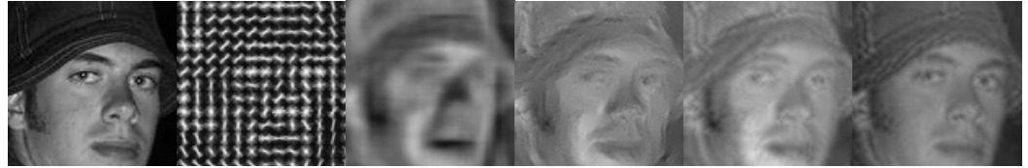
Objective
To what extent is it possible to reconstruct an image from its encoding?
Mahendran, A., & Vedaldi, A. (2014). Understanding deep image representations by inverting them. arXiv (Cornell University). https://doi.org/10.48550/arxiv.1412.0035

Slide 18
Inversion Method
Objective
Find an Image that matches target representation
Optimization
Optimize a function to inverse this representation
Loss Function
Use Euclidean Distance
Regularizers
Two regularizers, Rα​ and Rvβ​​,
Used to enforce specific characteristics in the inverted image:
Staying within a target interval
promoting piece-wise constancy.
Balancing Terms
Parameters like λ, α, and β are carefully tuned

Slide 19
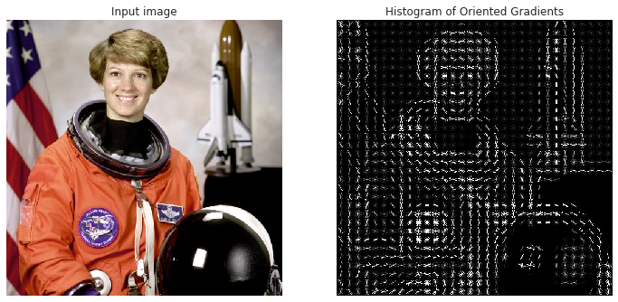
Optimization Process
So what did HOG and DSIFT essentially do ?
x
x
y= x³ + x2 + 4
Mittal, K. (2021, December 24). A gentle introduction into the histogram of oriented gradients. Medium. https://medium.com/analytics-vidhya/a-gentle-introduction-into-the-histogram-of-oriented-gradients-fdee9ed8f2aa

Slide 20
Optimization Process
One Problem!
The Equation is not deriveable
Hence we they used a CNN Framework to turn
DISIFT into CNN-DSIFT and
HOG into CNN-HOG

Slide 21
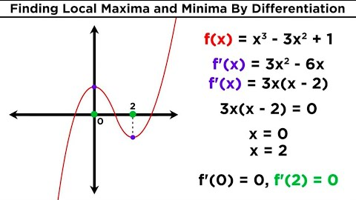
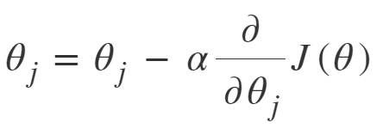
Optimization Process
1
Professor Dave Explains. (2018, April 3). Finding local maxima and minima by differentiation [Video]. YouTube. https://www.youtube.com/watch?v=pvLj1s7SOtk
2
x ∗ = argmin x∈RH×W×C `(Φ(x), Φ0) + λR(x) (1)
Our Image !
3
GeeksforGeeks. (2023, April 23). Difference between Batch Gradient Descent and Stochastic Gradient Descent. https://www.geeksforgeeks.org/difference-between-batch-gradient-descent-and-stochastic-gradient-descent/

Slide 22
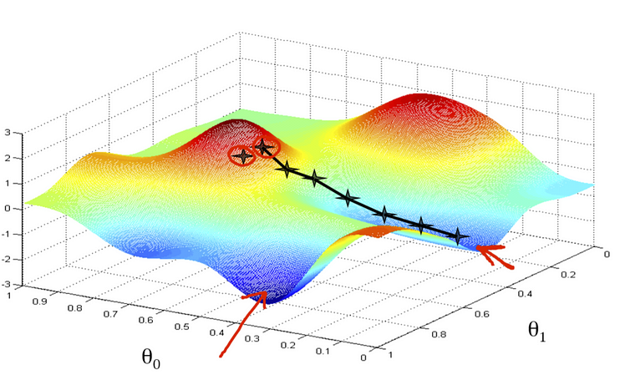
Optimization Process
Momentum Extension
GD incorporates a weighted average of recent gradients to improve convergence during learning.
Learning Process
Fixed Learning Rate
Gradually decreasing
Derivative Computation
To efficiently compute derivatives needed for GD, backpropagation.
This is possible due to the translation of HOG and DSIFT into a Convolutional Neural Network (CNN).
Mba, T. S. M. (2021, December 13). An intuitive explanation of gradient descent - towards data science. Medium. https://towardsdatascience.com/an-intuitive-explanation-of-gradient-descent-83adf68c9c33

Slide 23
Recap
So what are we doing again?
CNN
Framework 1.CNN-DSIFT 2.CNN-HOG
HOG
Deriveable
Equation
DSIFT
Optimization
Method
Optimize Function
Find the image

Slide 24
Application of Inversion Technique
Improving Interpretability of CNNs
Enhancing Computer Vision Techniques
Robustness and Security
Model Optimization
Neural Network Debugging
Medical Imaging

Slide 25
Results and Conclusion
The study compared its inversion method with HOGgle.
Although HOGgle is faster, the proposed method showed superior accuracy
(66% vs 28% reconstruction error).
DSIFT, provided reconstructions that were both quantitatively and qualitatively superior
Reconstructions demonstrated the locality of CNN features and the potential for smaller effective receptive fields.

Slide 26
Summary

Slide 27
Summary
Similarities
Both papers aim to provide insights into the feature representations learned by CNNs.
They use visualization techniques to understand what activates certain neurons or layers within the networks.
Each study works toward improving the interpretability of CNNs, which is crucial for improving model architectures and troubleshooting.

Slide 28
Summary
Dissimilarities
Aspect | "Visualizing and Understanding Convolutional Networks" by Zeiler and Fergus | “Understanding Deep Image Representations by Inverting Them” by Mahendran and Vedaldi's Paper
Objective | To provide insights into CNN feature representations and improve model interpretability. | To invert image representations in CNNs for better understanding and visualization.
Approach | Uses a deconvolutional network approach to map features back to input space. | Applies an optimization method to invert representations to the image space.
Improvements Based on Findings | Adjusts CNN architectures for better ImageNet performance. | Proposes potential improvements in the interpretability of CNNs.
Feature Visualization | Focuses on what activates neurons or layers. | Looks at invariance and abstraction in representations.

Slide 29
Thank you for your Attention!

Slide 30
References
Zeiler, M. D., & Fergus, R. (2014). Visualizing and understanding convolutional networks. In Lecture Notes in Computer Science (pp. 818–833). https://doi.org/10.1007/978-3-319-10590-1_53
OpenCV: Introduction to SIFT (Scale-Invariant Feature Transform). (n.d.). https://docs.opencv.org/3.4/da/df5/tutorial_py_sift_intro.html​
Mittal, K. (2021, December 24). A gentle introduction into the histogram of oriented gradients. Medium. https://medium.com/analytics-vidhya/a-gentle-introduction-into-the-histogram-of-oriented-gradients-fdee9ed8f2aa
Mahendran, A., & Vedaldi, A. (2014). Understanding deep image representations by inverting them. arXiv (Cornell University). https://doi.org/10.48550/arxiv.1412.0035
Mba, T. S. M. (2021, December 13). An intuitive explanation of gradient descent - towards data science. Medium. https://towardsdatascience.com/an-intuitive-explanation-of-gradient-descent-83adf68c9c33
Professor Dave Explains. (2018, April 3). Finding local maxima and minima by differentiation [Video]. YouTube. https://www.youtube.com/watch?v=pvLj1s7SOtk
GeeksforGeeks. (2023, April 23). Difference between Batch Gradient Descent and Stochastic Gradient Descent. https://www.geeksforgeeks.org/difference-between-batch-gradient-descent-and-stochastic-gradient-descent/
Mittal, K. (2021, December 24). A gentle introduction into the histogram of oriented gradients. Medium. https://medium.com/analytics-vidhya/a-gentle-introduction-into-the-histogram-of-oriented-gradients-fdee9ed8f2aa
Mahendran, A., & Vedaldi, A. (2014). Understanding deep image representations by inverting them. arXiv (Cornell University). https://doi.org/10.48550/arxiv.1412.0035

Slide 31
Backup Slides

Slide 32
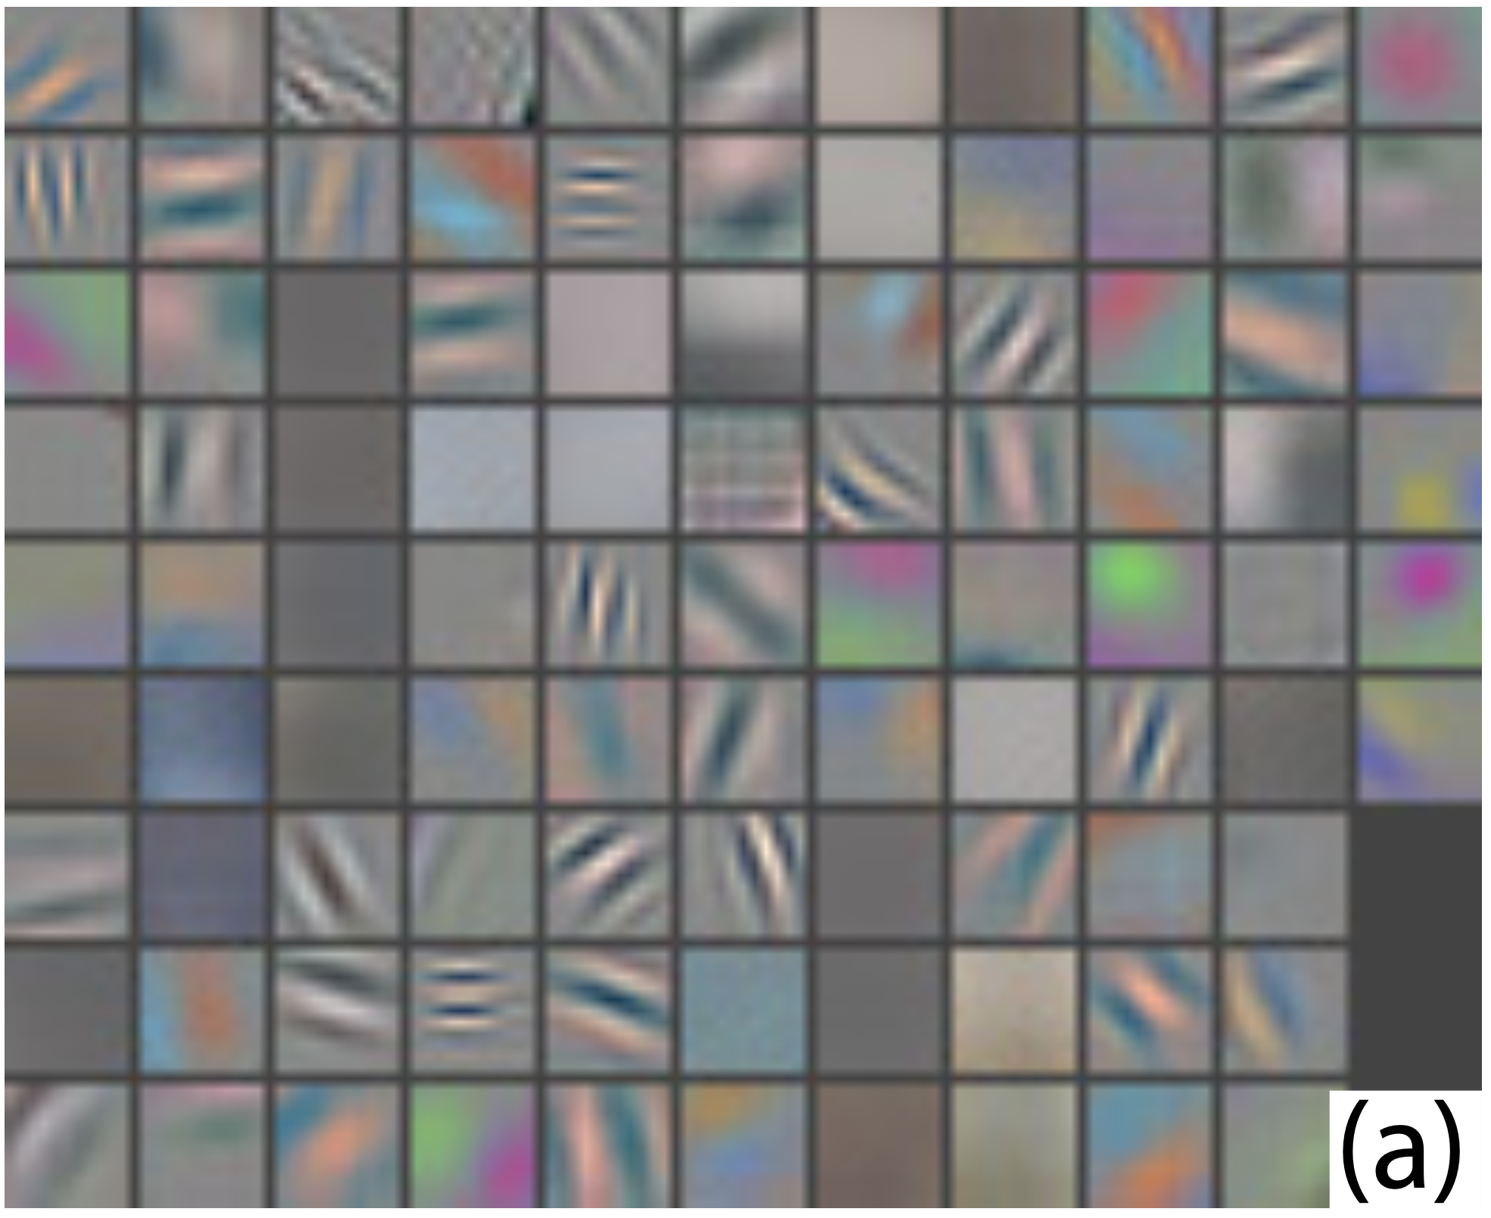
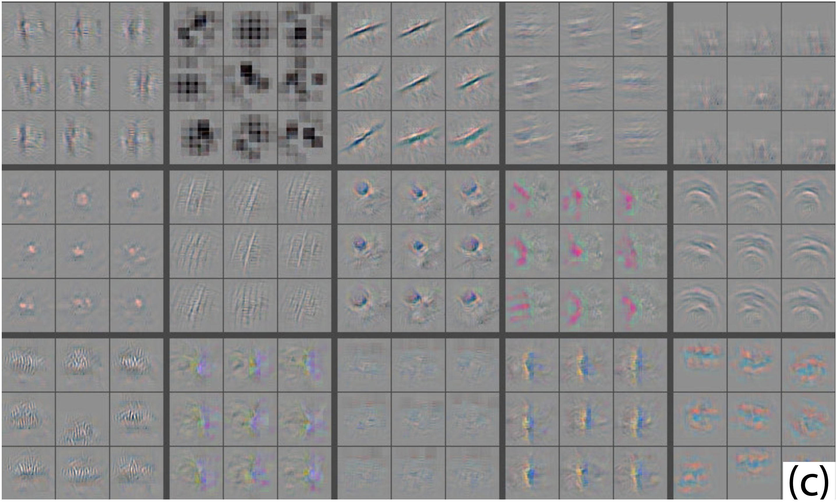
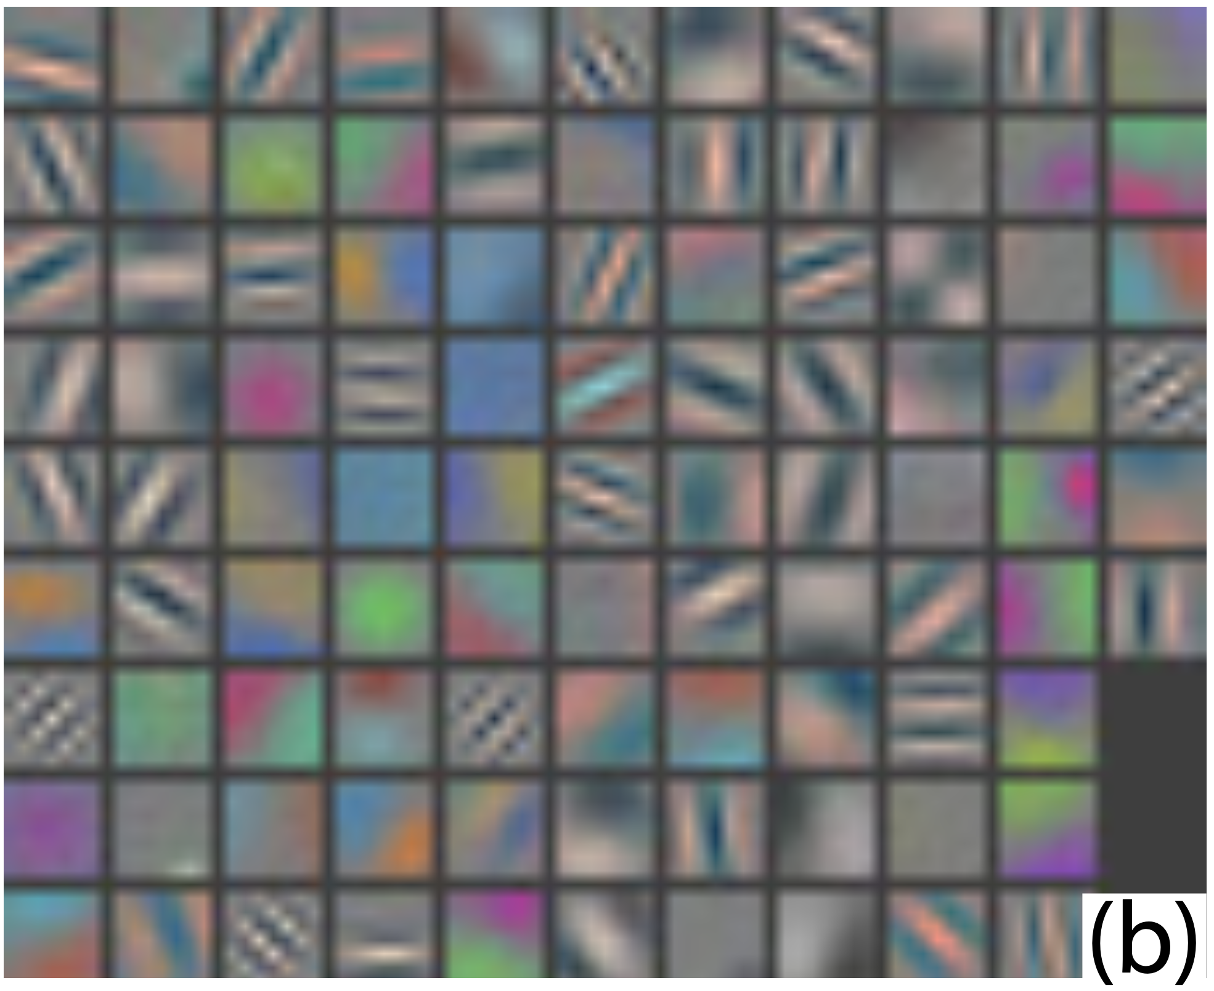
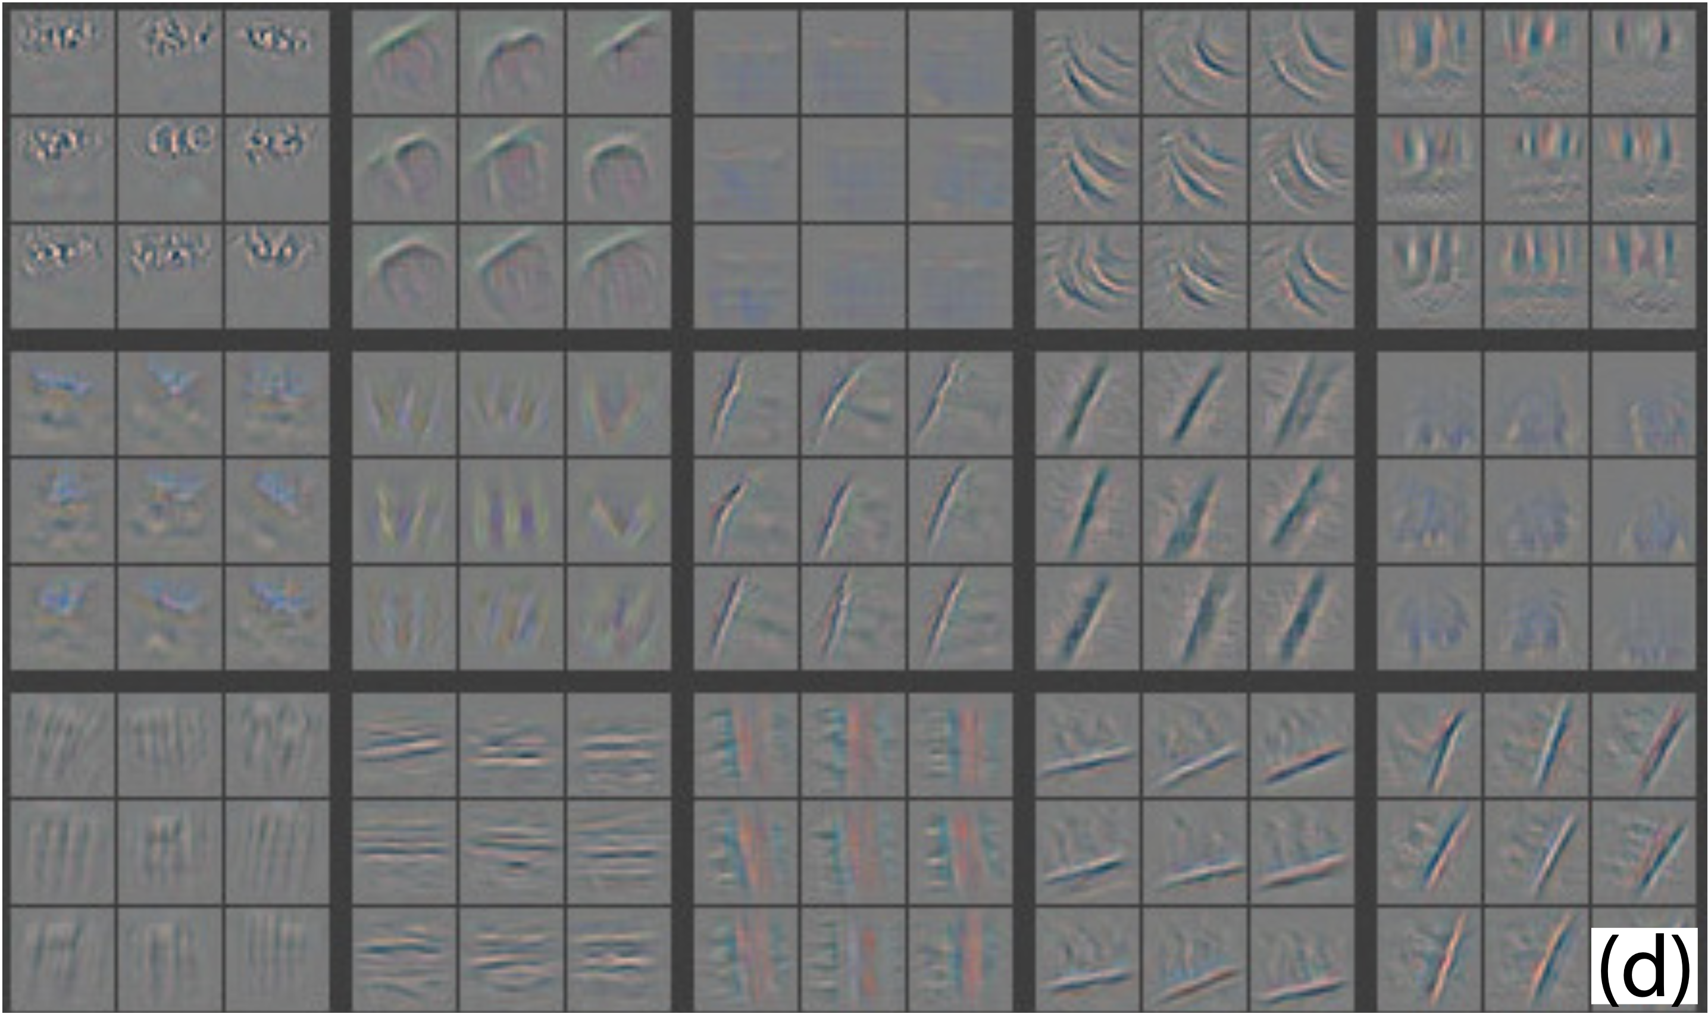
Improving Model Architecture
Layer 1
Layer 2
problems (with Krizhevsky et al.‘s architecture)
layer 1: extremely high and low frequency information
layer 2: aliasing artifacts
remedies
layer 1 filter size reduction (11x11 to 7x7)
layer 1 stride reduction (4 to 2)
Krizhevsky et al. (2012)
Zeiler & Fergus (2014)
Krizhevsky, A., Sutskever, I., & Hinton, G. E. (2012b). ImageNet Classification with Deep Convolutional Neural Networks. Neural Information Processing Systems, 25, 1097–1105. http://books.nips.cc/papers/files/nips25/NIPS2012_0534.pdf
Zeiler, M. D., & Fergus, R. (2014). Visualizing and understanding convolutional networks. In Lecture Notes in Computer Science (pp. 818–833). https://doi.org/10.1007/978-3-319-10590-1_53

Slide 33
Representations
Directional Filtering and Gating
Apply directional filters to image gradients.
Use gating functions to assign gradients to bins based on orientation.
Captures gradient directions and assigns them to orientation bins, preserving crucial directional information.
Approximate Bilinear Binning
An alternative to exact binning.
Utilizes a norm-dependent offset and ReLU operator.
Offers an efficient way to perform binning within CNN operations.
Directional Filtering and Gating
Approximate Bilinear Binning

Slide 34
Representations
Spatial Pooling and Block Extraction
Pool binned gradients into cell histograms.
Extract blocks of cells (2x2 for HOG, 4x4 for DSIFT).
Normalization
Apply L2 normalization to cell blocks
Ensures consistent descriptor norms for accurate feature comparisons.
Descriptor Refinement
Decompose blocks into cells.
Clamp descriptor values from above using a combination of linear and ReLU layers.
Improves representation quality by aligning it with traditional methods.
Spatial Pooling and Block Extraction
Normalization
Descriptor Refinement

